Slide 1
Introduction to Iptables

Slide 2
IPtables
Objectives
to learn the basics of iptables
Contents
Start and stop IPtables
Checking IPtables status
Input and Output chain
Pre and Post routing
Forward of address and port
Firewall standard rules
Lading/Unloading kernel driver modules
Connection tracking modules
Practicals
working with iptables
Summary
Notes:
This chapter introduces the US DoD Internet suite known as TCP/IP (Transmission Control Protocol/Internet Protocol). It covers TCP/IP as a set of protocols and how they fit them into a communications model, the addressing scheme used for Interhost/Internetwork communication (IP addressing) and finally at some applications that use them.

Slide 3
What Is iptables?
Stateful packet inspection.
The firewall keeps track of each connection passing through it, This is an important feature in the support of active FTP and VoIP.
Filtering packets based on a MAC address IPv4 / IPv6
Very important in WLAN’s and similar enviroments.
Filtering packets based the values of the flags in the TCP header
Helpful in preventing attacks using malformed packets and in restricting access.
Network address translation and Port translating NAT/NAPT
Building DMZ and more flexible NAT enviroments to increase security.
Source and stateful routing and failover functions
Route traffic more efficiant and faster than regular IP routers.
System logging of network activities
Provides the option of adjusting the level of detail of the reporting
A rate limiting feature
Helps to block some types of denial of service (DoS) attacks.
Packet manipulation (mangling) like altering the TOS/DSCP/ECN bits of the IP header
Mark and classify packets dependent on rules. First step in QoS.
Notes:
What is netfilter/iptables?
netfilter and iptables are building blocks of a framework inside the Linux 2.4.x and 2.6.x kernel. This framework enables packet filtering, network address [and port] translation (NA[P]T) and other packet mangling. It is the re-designed and heavily improved successor of the previous Linux 2.2.x ipchains and Linux 2.0.x ipfwadm systems.

Slide 4
Download & Install Iptables Package
Most Linux dialects already have iptables
Usally iptables is classified by and dependent on kernel versions:
Pre 2.4 lack some modern functionality, still popular in soho routers
2.4 mainstream of iptables, most popular and well tested
2.6 latest versions
Download from:
http://www.netfilter.org/downloads.html
Documentation:
http://www.netfilter.org/documentation/index.html
Install from sources or rpm:
# rpm –ivh iptables-1.2.9-1.0.i386.rpm
# tar xvfz iptables-1.2.9.tar.gz ; ./configure ; make ; make install
Modules to add functionallity to IPtables:
Variour proxy modules, for example ftp and h323
Modules must be loaded into kernel
# modprobe module
# insmod module
Patch-o-Matic (updated and modules)
http://ftp.netfilter.org/pub/patch-o-matic-ng/snapshot/
Notes:
A large number of plugins/modules kept in 'patch-o-matic' repository. Note that Iptables is heavely dependent on you linux kernel.
Addons and functionallity in iptables is often on kernel level, which make them very sencitive to kernel version.

Slide 5
How To Start iptables
You can start, stop, and restart iptables after booting by using the commands:
Starting IP tables
service iptables start
Stopping IP tables
service iptables stop
Restaring IP tables
service iptables restart
Checking IP tables status (rulechains)
service iptables status
To get iptables configured to start at boot, use the chkconfig command:
chkconfig iptables on
iptables itself is a command which we will see soon.
To show all current rule chains:
iptables –-list
To drop all current rule chains:
iptables –-flush
Notes:
The service and chkconfig commands above is working on all firewalls based on redhat distributions. Other uses scripts.

Slide 6
Packet Processing In iptables
IP tables is complex for the beginner.
Three builtin tables (queues) for processing:
1. MANGLE: manipulate QoS bits in TCP header
2. FILTER: packet filtering, has three builtin chains (your firewall policy rules)
Forward chain: filters packets to servers protected by firewall
Input chain: filters packets destinated for the firewall
Output chain: filters packets orginating from the firewall
3. NAT: network adress translation, has two builtin chains
Pre-routing: NAT packets when destination address need changes
Post-routing: NAT packets when source address need changes
Notes:
All packets inspected by iptables pass through a sequence of built-in tables (queues) for processing. Each of these queues is dedicated to a particular type of packet activity and is controlled by an associated packet transformation/filtering chain.
There are three tables in total. The first is the mangle table which is responsible for the alteration of quality of service bits in the TCP header. This is hardly used in a home or SOHO environment.
The second table is the filter queue which is responsible for packet filtering. It has three built-in chains in which you can place your firewall policy rules.
The third table is the nat queue which is responsible for network address translation. It has two built-in chain

Slide 7
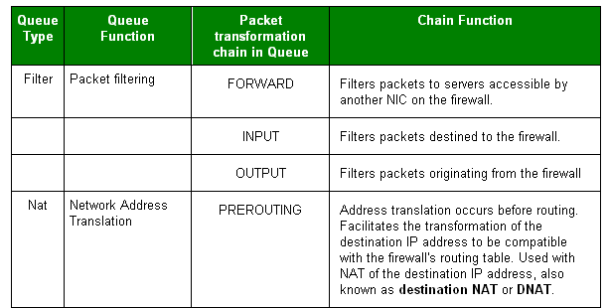
Firewalling packets (1/2)
Notes:
You need to specify the table and the chain for each firewall rule you create. There is an exception: Most rules are related to filtering, so iptables assumes that any chain that's defined without an associated table will be a part of the filter table. The filter table is therefore the default.

Slide 8
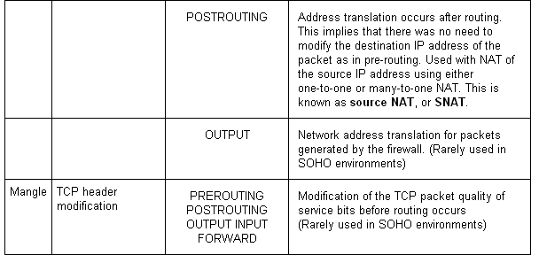
Firewalling packets (2/2)
Notes:
Postrouting rules can make packages leaving the firewall, appair as coming from selected source addresses, SNAT.

Slide 9
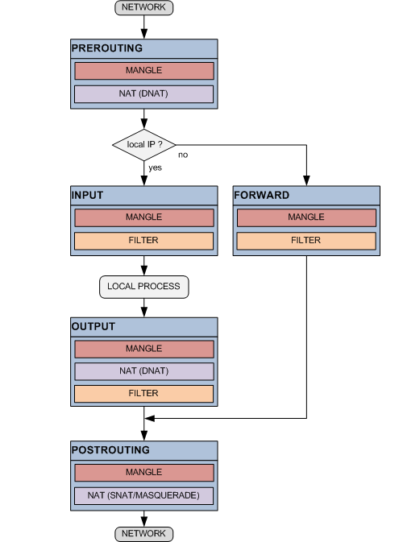
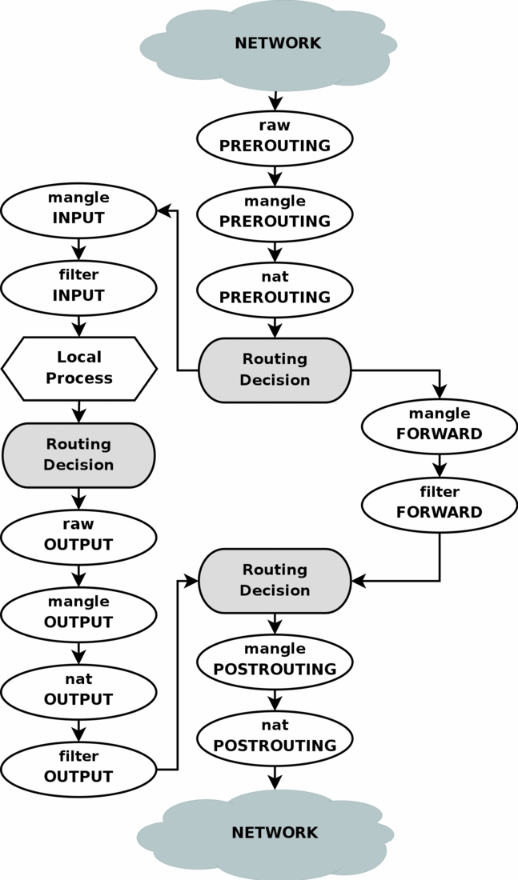
Chain Hierarchy
Notes:
To help understand iptables, take a look at the way packets are handled by iptables. In figure a TCP packet from the Internet arrives at the firewall's interface on Network A to create a data connection.
The packet is first examined by your rules in the mangle table's PREROUTING chain, if any. It is then inspected by the rules in the nat table's PREROUTING chain to see whether the packet requires DNAT. It is then routed.
If the packet is destined for a protected network, then it is filtered by the rules in the FORWARD chain of the filter table and, if necessary, the packet undergoes SNAT before arriving at Network B. When the destination server decides to reply, the packet undergoes the same sequence of steps.
If the packet is destined for the firewall itself, then it is filtered by the rules in the INPUT chain of the filter table before being processed by the intended application on the firewall. At some point, the firewall needs to reply. This reply is inspected by your rules in the OUTPUT chain of the mangle table, if any. The rules in the OUTPUT chain of the nat table determine whether address translation is required and the rules in the OUTPUT chain of the filter table are then inspected before the packet is routed back to the Internet.

Slide 10
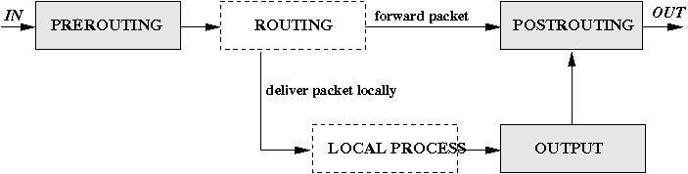
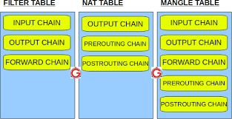
Chain Hierarchy

Slide 11
Targets And Jumps 1/2
ACCEPT
iptables stops further processing.
The packet is handed over to the end application or the operating system for processing
DROP
iptables stops further processing.
The packet is blocked.
LOG
The packet information is sent to the syslog daemon for logging.
iptables continues processing with the next rule in the table.
You can't log and drop at the same time ->use two rules.
--log-prefix ”reason"
REJECT
Works like the DROP target, but will also return an error message to the host sending the packet that the packet was blocked
--reject-with qualifier Qualifier is an ICMP message
Notes:
Each firewall rule inspects each IP packet and then tries to identify it as the target of some sort of operation. Once a target is identified, the packet needs to jump over to it for further processing.

Slide 12
Targets And Jumps 2/2
SNAT
Used to do source network address translation rewriting the source IP address of the packet
The source IP address is user defined
--to-source <address>[-<address>][:<port>-<port>]
DNAT
Used to do destination network address translation. ie. rewriting the destination IP address of the packet
--to-destination ipaddress
MASQUERADE
Used to do Source Network Address Translation.
By default the source IP address is the same as that used by the firewall's interface
[--to-ports <port>[-<port>]]
Notes:
Masquerade is the way of doing classing NAT, it is actually built upon the SNAT and DNAT.
The SNAT, DNAT makes the logical DMZ possible. It is not advisable to do SNAT and DNAT for certain ports into the controlled zones.

Slide 13
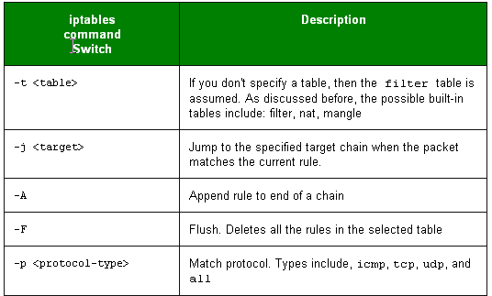
Iptables Command Switch Operations 1/2
Notes:
Firewall rules is stored in scripts or databases, most common is scripts.
One row example:
iptables -A INPUT -s 0/0 -i eth0 -d 192.168.1.1 -p TCP -j ACCEPT
Each line of an iptables script not only has a jump, but they also have a number of command line options that are used to append rules to chains that match your defined packet characteristics, such the source IP address and TCP port. There are also options that can be used to just clear a chain so you can start all over again.

Slide 14
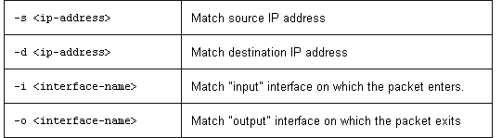
Iptables Command Switch Operations 2/2
We try to define a rule that will accept all packages on interface eth0 that uses TCP and has destination address 192.168.1.1.
We first define the MATCH criterias:
Use default filter table (absense of –t )
Append a rule to end of INPUT chain (-A INPUT )
Match on source address can be any 0/0 address (-s 0/0 )
Input interface used is eth0 (-i eth0 )
Match on destination address 192.168.1.1 (-d 192.168.1.1)
Match Protocol TCP (-p TCP )
If all matches is fulfilled, then jump to ACCEPT chain. (-j ACCEPT )
iptables -A INPUT -s 0/0 -i eth0 -d 192.168.1.1 -p TCP -j ACCEPT
Notes:
iptables is being configured to allow the firewall to accept TCP packets coming in on interface eth0 from any IP address destined for the firewall's IP address of 192.168.1.1. The 0/0 representation of an IP address means any

Slide 15
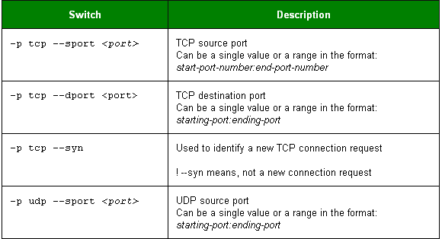
Common TCP and UDP Match Criteria
Notes:
Example:
iptables -A FORWARD -s 0/0 -i eth0 -d 192.168.1.58 -o eth1 -p TCP \
--sport 1024:65535 --dport 80 -j ACCEPT
iptables is being configured to allow the firewall to accept TCP packets for routing when they enter on interface eth0 from any IP address and are destined for an IP address of 192.168.1.58 that is reachable via interface eth1. The source port is in the range 1024 to 65535 and the destination port is port 80 (www/http).

Slide 16
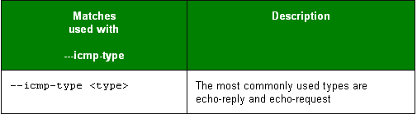
Common ICMP (Ping) Match Criteria
Allow ping request and reply
iptables is being configured to allow the firewall to send ICMP echo-requests (pings) and in turn, accept the expected ICMP echo-replies.
iptables -A OUTPUT -p icmp --icmp-type echo-request -j ACCEPT
iptables -A INPUT -p icmp --icmp-type echo-reply -j ACCEPT
Put limit on ping to prevent flood pings
iptables -A INPUT -p icmp --icmp-type echo-request \
-m limit --limit 1/s -i eth0 -j ACCEPT
Notes:
To stop ICMP traffic can result in that TCP protocol and UDP protocol builtin and applicaton dependend throttle functions are knocked out. As result, the network can be instable during heavy load.
Ping is not important for network stability in most cases, and can be turned off if you want to stop ping-scans for live hosts!
The limit feature in iptables specifies the maximum average number of matches to allow per second. You can specify time intervals in the format /second, /minute, /hour, or /day, or you can use abbreviations so that 3/second is the same as 3/s.
In the limit example, ICMP echo requests are restricted to no more than one per second. When tuned correctly, this feature allows you to filter unusually high volumes of traffic that characterize denial of service (DOS) attacks and Internet worms.

Slide 17
Defense for SYN flood attacks
–m limit sets maximum number of SYN packets
iptables is being configured to allow the firewall to accept maxim 5 TCP/SYN packeds per second on interface eth0.
iptables -A INPUT -p tcp --syn -m limit --limit 5/s -i eth0 -j ACCEPT
If more than 5 SYN packets per second, the packets are dropped.
If source/destination sence dropped packets, it will resend three times
If drops continue after 3 reset packets, source will reduce packet speed.
Notes:
You can expand on the limit feature of iptables to reduce your vulnerability to certain types of denial of service attack. Here a defense for SYN flood attacks was created by limiting the acceptance of TCP segments with the SYN bit set to no more than five per second.

Slide 18
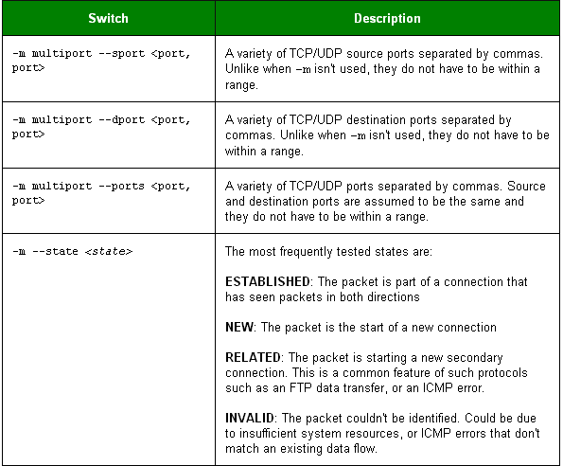
Common Extended Match Criteria 1/2

Slide 19
Common Extended Match Criteria 2/2
Allow both port 80 and 443 for the webserver on inside:
iptables -A FORWARD -s 0/0 -i eth0 -d 192.168.1.58 -o eth1 -p TCP \
--sport 1024:65535 -m multiport --dport 80,443 -j ACCEPT
The return traffic from webbserver is allowed, but only of sessions are opened:
iptables -A FORWARD -d 0/0 -o eth0 -s 192.168.1.58 -i eth1 -p TCP \
-m state --state ESTABLISHED -j ACCEPT
If sessions are used, you can reduce an attack called half open
Half open is known to consume server all free sockets (tcp stack memory) and is senced as a denial of service attack, but it is not.
Sessions are usally waiting 3 minutes.
Notes:
Here iptables is being configured to allow the firewall to accept TCP packets to be routed when they enter on interface eth0 from any IP address destined for IP address of 192.168.1.58 that is reachable via interface eth1. The source port is in the range 1024 to 65535 and the destination ports are port 80 (www/http) and 443 (https). The return packets from 192.168.1.58 are allowed to be accepted too. Instead of stating the source and destination ports, you can simply allow packets related to established connections using the -m state and --state ESTABLISHED options.

Slide 20
Using User Defined Chains
Define fast input queue:
iptables -A INPUT -i eth0 -d 206.229.110.2 -j fast-input-queue
Define fast output queue:
iptables -A OUTPUT -o eth0 -s 206.229.110.2 -j fast-output-queue
Use defined queues and define two icmp queue’s:
iptables -A fast-input-queue -p icmp -j icmp-queue-in
iptables -A fast-output-queue -p icmp -j icmp-queue-out
Finally we use the queue’s to define a two rules:
iptables -A icmp-queue-out -p icmp --icmp-type echo-request \ -m state --state NEW -j ACCEPT
iptables -A icmp-queue-in -p icmp --icmp-type echo-reply -j ACCEPT
Notes:
You can configure iptables to have user-defined chains. This feature is frequently used to help streamline the processing of packets. For example, instead of using a single, built-in chain for all protocols, you can use the chain to determine the protocol type for the packet and then hand off the actual final processing to a user-defined, protocol-specific chain in the filter table. In other words, you can replace a long chain with a stubby main chain pointing to multiple stubby chains, thereby shortening the total length of all chains the packet has to pass through.
Use user defined queues, improved throughput speed due to more efficiant memory handling and queue processing inside the kernel.

Slide 21
Saving Your iptables Scripts
RedHat based distributions:
/etc/sysconfig/iptables
Other distributions uses:
There is no specific favourite place, one is:
/etc/rc.d/rc.firewall
And maby this is the most common is:
/etc/init.d/rc.firewall
RedHat/Fedora's iptables Rule Generator:
lokkit
There are three iptable commands:
iptables (The kernel insert rule command)
iptables-save > rc.firewall.backup
iptables-restore < rc.firewall.backup
In RedHat/Fedora you can also:
service iptables save
Notes:
For RedHat based distrubutions:
The service iptables save command permanently saves the iptables configuration in the /etc/sysconfig/iptables file. When the system reboots, the iptables-restore program reads the configuration and makes it the active configuration.
The format of the /etc/sysconfig/iptables file is slightly different from that of the scripts shown in this chapter. The initialization of built-in chains is automatic and the string "iptables" is omitted from the rule statements.
Fedora comes with a program called lokkit that you can use to generate a very rudimentary firewall rule set. It prompts for the level of security and then gives you the option of doing simple customizations. It is a good place for beginners to start on a test system so that they can see a general rule structure.
Like the service iptables save command, lokkit saves the firewall rules in a new /etc/sysconfig/iptables file for use on the next reboot.
Once you have become familiar with the iptables syntax, it's best to write scripts that you can comment and then save it to /etc/sysconfig/iptables. It makes them much more manageable and readable.

Slide 22
Loading Kernel Modules for iptables
Loading kernel modules extends it functionallity
Generally kernel modules is like plugins, they add functionallity:
/lib/modules/2.4.20-30.9/kernel/net/
Manually loading/unloading modules
modprobe <module> (search for module and dependencies)
insmod <module> (force load module, dont care)
rmmod <module> (remove module)
lsmod (List modules loaded)
Load some common modules:
modprobe ip_conntrack (tracking connections)
modprobe ip_conntrack_ftp (transparent proxy for active ftp)
modprobe iptable_nat (for all kind of NAT operations)
modprobe ip_nat_ftp (for ftp server behind nat)
Notes:
The iptables application requires you to load certain kernel modules to activate some of its functions. Whenever any type of NAT is required, the iptable_nat module needs to be loaded. The ip_conntrack_ftp module needs to be added for FTP support and should always be loaded with the ip_conntrack module which tracks TCP connection states. As most scripts probably will keep track of connection states, the ip_conntrack module will be needed in any case. The ip_nat_ftp module also needs to be loaded for FTP servers behind a NAT firewall.

Slide 23
Παραδείγμα χρήσης iptables
Delete Existing Rules
iptables -F (or) iptables --flush
Set Default Chain Policies
iptables -P INPUT DROP
iptables -P FORWARD DROP
iptables -P OUTPUT DROP
Block a Specific ip-address
iptables -A INPUT -s "$BLOCK_THIS_IP" -j DROP
iptables -A INPUT -i eth0 -s "$BLOCK_THIS_IP" -j DROP
iptables -A INPUT -i eth0 -p tcp -s "$BLOCK_THIS_IP" -j DROP
Allow Incoming SSH only from a Specific Network
iptables -A INPUT -i eth0 -p tcp -s 192.168.100.0/24 --dport 22 -m state --state NEW,ESTABLISHED -j ACCEPT
iptables -A OUTPUT -o eth0 -p tcp --sport 22 -m state --state ESTABLISHED -j ACCEPT

Slide 24
Παραδείγμα χρήσης iptables
Multiple Rules Together using MultiPorts
iptables -A INPUT -i eth0 -p tcp -m multiport --dports 22,80,443 -m state --state NEW,ESTABLISHED -j ACCEPT
iptables -A OUTPUT -o eth0 -p tcp -m multiport --sports 22,80,443 -m state --state ESTABLISHED -j ACCEPT
Allow Outgoing traffic ie HTTPS, SSH
iptables -A OUTPUT -o eth0 -p tcp --dport 443 -m state --state NEW,ESTABLISHED -j ACCEPT
iptables -A INPUT -i eth0 -p tcp --sport 443 -m state --state ESTABLISHED -j ACCEPT
iptables -A OUTPUT -o eth0 -p tcp -d 192.168.100.0/24 --dport 22 -m state --state NEW,ESTABLISHED -j ACCEPT
iptables -A INPUT -i eth0 -p tcp --sport 22 -m state --state ESTABLISHED -j ACCEPT

Slide 25
Παραδείγμα χρήσης iptables
Allow Ping
iptables -A OUTPUT -p icmp --icmp-type echo-request -j ACCEPT
iptables -A INPUT -p icmp --icmp-type echo-reply -j ACCEPT
Allow Internal Network to External network.
iptables -A FORWARD -i eth0 -o eth1 -j ACCEPT
Allow outbound DNS
iptables -A OUTPUT -p udp -o eth0 --dport 53 -j ACCEPT
iptables -A INPUT -p udp -i eth0 --sport 53 -j ACCEPT
Prevent DoS Attack
iptables -A INPUT -p tcp --dport 80 -m limit --limit 25/minute --limit-burst 100 -j ACCEPT

Slide 26
Παραδείγμα χρήσης iptables
Port Forwarding
iptables -t nat -A PREROUTING -p tcp -d 192.168.102.37 --dport 422 -j DNAT --to 192.168.102.37:22
Log Dropped Packets
iptables -N LOGGING
iptables -A INPUT -j LOGGING
iptables -A LOGGING -m limit --limit 2/min -j LOG --log-prefix "IPTables Packet Dropped: " --log-level 7

Slide 27
Ασφάλεια με iptables
#Force SYN packets check
#Make sure NEW incoming tcp connections are SYN packets; otherwise we need to drop them:
iptables -A INPUT -p tcp ! --syn -m state --state NEW -j DROP
#Force Fragments packets check
#Packets with incoming fragments drop them. This attack result into Linux server panic such data loss.
iptables -A INPUT -f -j DROP
#XMAS packets (in an X-mas attack, a specially crafted TCP packet where Urgent, Push and Fin flags turned on are sent)
Incoming malformed XMAS packets drop them:
iptables -A INPUT -p tcp --tcp-flags ALL ALL -j DROP

Slide 28
Ασφάλεια με iptables
#Drop all NULL packets
#Incoming malformed NULL packets:
iptables -A INPUT -p tcp --tcp-flags ALL NONE -j DROP
# Drop packet that claiming from our own server on WAN port
iptables -A INPUT -i eno1 -s 150.140.139.251 -j DROP
iptables -A OUTPUT -o eno1 -s 150.140.139.251 -j DROP
iptables -A INPUT -i eno2 -s 150.140.139.250 -j DROP
iptables -A OUTPUT -o eno2 -s 150.140.139.250 -j DROP
LAN_RANGE="192.168.1.0/24" # your LAN IP range
# Drop packet that claiming from our own internal LAN on WAN port
iptables -A INPUT -i eno1 -s $LAN_RANGE -j DROP
iptables -A OUTPUT -o eno1 -s $LAN_RANGE -j DROP

Slide 29
Ασφάλεια με iptables
# Add your spoofed IP range/IPs here
SPOOF_IPS="0.0.0.0/8 127.0.0.0/8 10.0.0.0/8 172.16.0.0/12 192.168.0.0/16 224.0.0.0/3"
for ip in $SPOOF_IPS
do
iptables -A INPUT -i eno1 -s $ip -j DROP
iptables -A OUTPUT -o eno1 -s $ip -j DROP
iptables -A INPUT -i eno2 -s $ip -j DROP
iptables -A OUTPUT -o eno2 -s $ip -j DROP
done
Drop some ICMP messages (ping and echo reply)
iptables -A INPUT -p icmp --icmp-type 8 -s 0/0 -d 150.140.139.251 -m state --state NEW,ESTABLISHED,RELATED -j DROP
iptables -A OUTPUT -p icmp --icmp-type 0 -s 150.140.139.251 -d 0/0 -m state --state ESTABLISHED,RELATED -j ACCEPT

Slide 30
TCP Flags
A TCP packet contains many flags.
Synchronization: This flag is sent when establishing a three-way handshake.
Acknowledgment: This flag is used to acknowledge the successful receipt of the packets.
Fin flag: This flag is used to finish the connections created using the SYN flag.
Reset: This flag is set to indicate the reset of the connection.
Urgent pointer: This flag is used to indicate to abort other segments so that the given segment is given priority.
Push: This flag is used to inform the receiving host to push data to the application immediately.

Slide 31
iptables on boot....
nano /etc/rc.local...
#!/bin/bash
#
................
οι εντολές iptables
iptables -A INPUT -m state --state ESTABLISHED,RELATED -j ACCEPT
iptables -A INPUT -i lo -j ACCEPT
iptables -A INPUT -i eno1 -s 150.140.139.193/26 -j ACCEPT
iptables -A INPUT -i eno2 -s 150.140.139.193/26 -j ACCEPT
iptables -A INPUT -m limit --limit 5/m -j LOG --log-prefix='[netfilter] '
iptables -P INPUT DROP
iptables -P FORWARD DROP
iptables -P OUTPUT ACCEPT
exit 0

Slide 32
Βασικές Αρχές προσταστίας
Καθορίστε την πολιτική σας: DROP (πάντα).
Ανοίξτε ΜΟΝΟ τις πόρτες που χρειάζεστε πχ 443 (όχι 80).
Επιτρέψτε υπηρεσία ssh μόνο από:
single IP
εσωτερική IP δικτύου (όλες?)
Χρήση VPN ?
1η εντολή: ACCEPT establisted connections.
τελευταια εντολή log packets
Ελέγχετε τακτικά το αρχείο των log πακέτων.
Φτιάξτε scripts για επεξεργασία των logged πακετων (sendmail, tracking Ips, geologation, etc).
Εάν υπάρχουν πολλοί servers στο τοπικό δίκτυο, επιτρέψτε όλη την κίνηση ΜΟΝΟ από περιορισμένα IP 150.140.139.193/XX.
Εκτελέστε port scaning...
Egress filtering: Ελέγχετε την κίνηση εξόδου. Όλες οι επιθέσεις πλέον γίνονται από “μέσα”, δλδ το εσωτερικό δίκτυο.
θυμηθείτε: DOS and DDOS είναι μόνο για επίδειξη!!

Slide 33
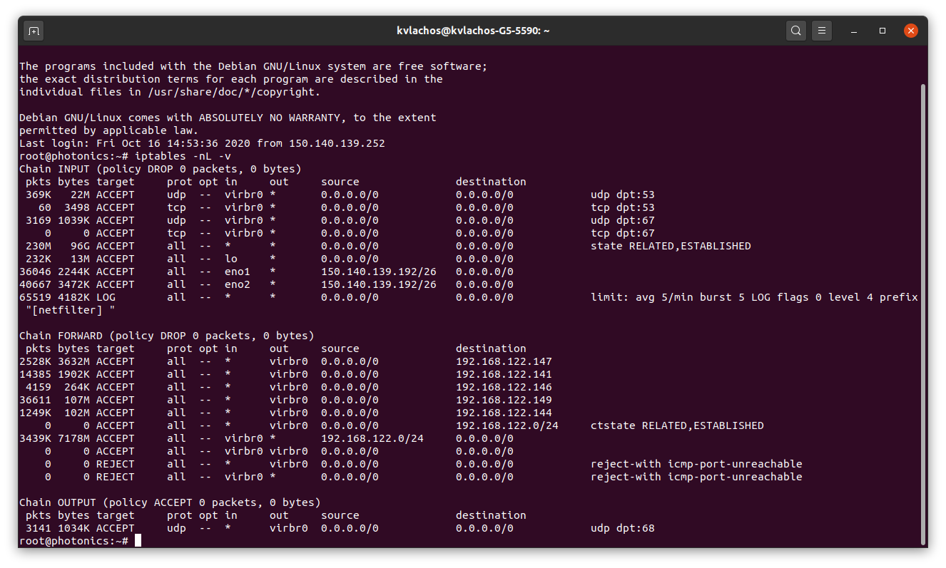
iptables -nL -v

Slide 34
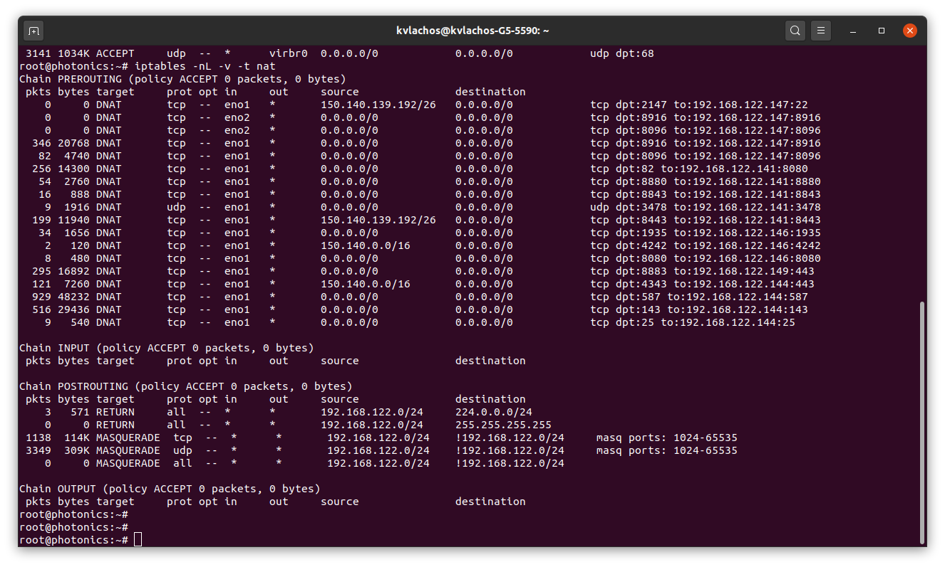
iptables -nL -v -t nat

